Slide 1
Project: Virtual Queue 2.0 Student: Kenneth Kon Michael Lazo Mentor: Bernard Parenteau
Sprint 4 Presentation
CIS 4911 Senior Project
School of Computing and Information Sciences
Florida International University
<04/06/2015>

Slide 2
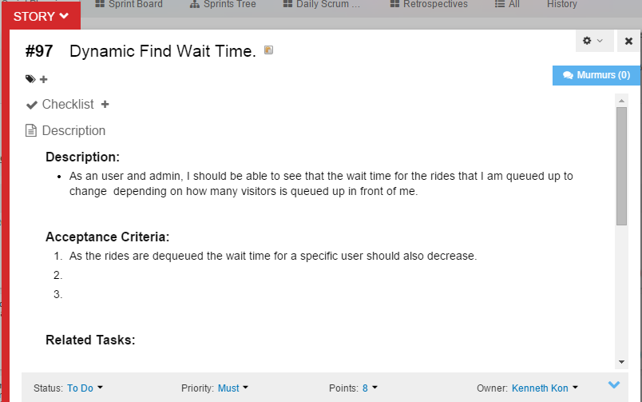
User Story
Sprint Velocity:
30 per Sprint

Slide 3
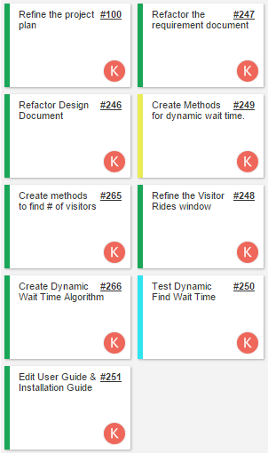
User Story: Tasks

Slide 4
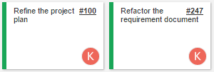
Daily Scrums 1 & 2
Daily Scrum 1
Preparing for Sprint 3 Presentations.
Presenting Sprint 3
Go over the Requirement elicitation on the User Story Assigned to us for Sprint 4 with a product owner.
Estimated points to work on: 5 points
Actual number of points work on: 5 points
Daily Scrum 2
Meeting for Sprint 4 with our product owner to go over:
Go over the Requirement elicitation on the User Story Assigned to us for Sprint 4 with a product owner.
Start editing project plan: adding sprint 4 Gantt chart
Create Dynamic Wait Time User Case and then sequence Diagram from it.
Estimated points to work on: 4 points
Actual number of points work on: 3 points

Slide 5
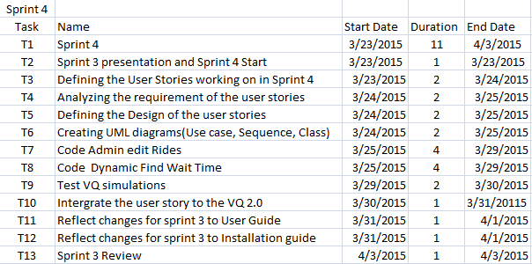
Added in Feasibility and Project Plan Document

Slide 6
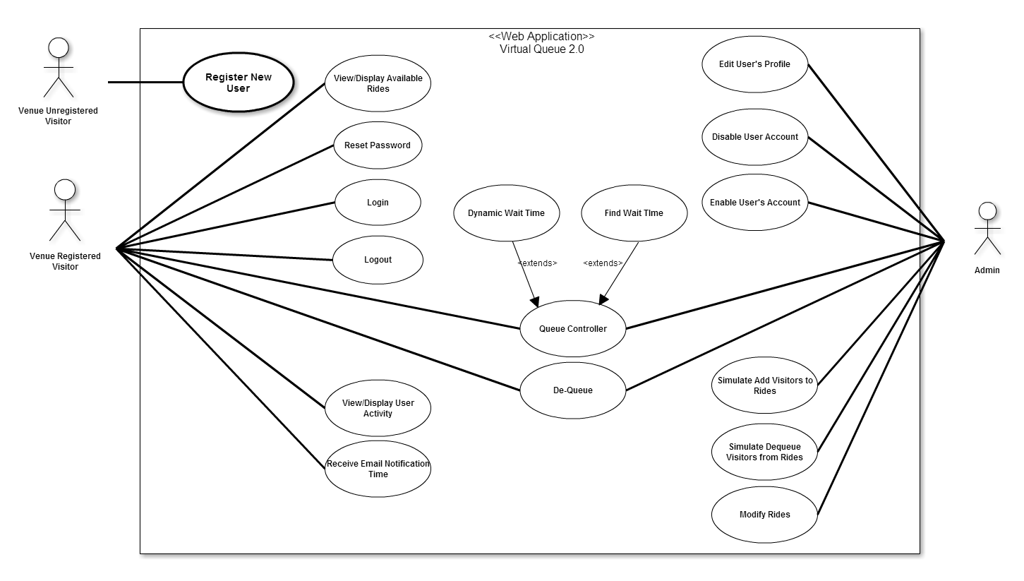
Use Case Diagram:
Edited in Requirement Document

Slide 7
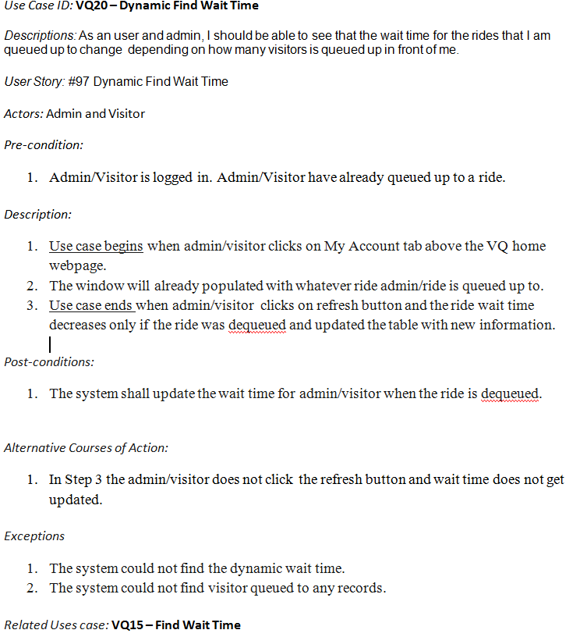
Use Case:
Added In Requirement Document

Slide 8
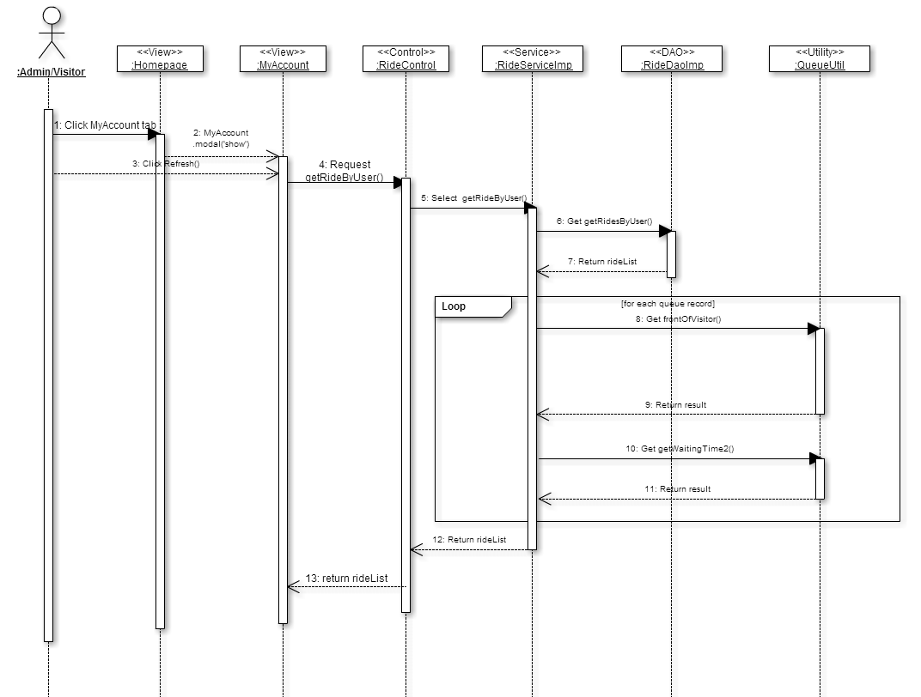
Sequence Diagram: Added In Requirement Document

Slide 9

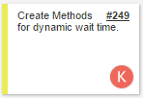
Daily Scrums 3 & 4
Daily Scrum 3
Create Class diagram for this class diagram, using the objects from created Sequence Diagram.
Finish creating all UML Diagram for the Dynamic Wait Time User Story.
Estimated points to work on: 5 points
Actual number of points work on: 4 points
Daily Scrum 4
Start coding methods in the objects class diagram.
Estimated points to work on: 6 points
Actual number of points work on: 3 points

Slide 10
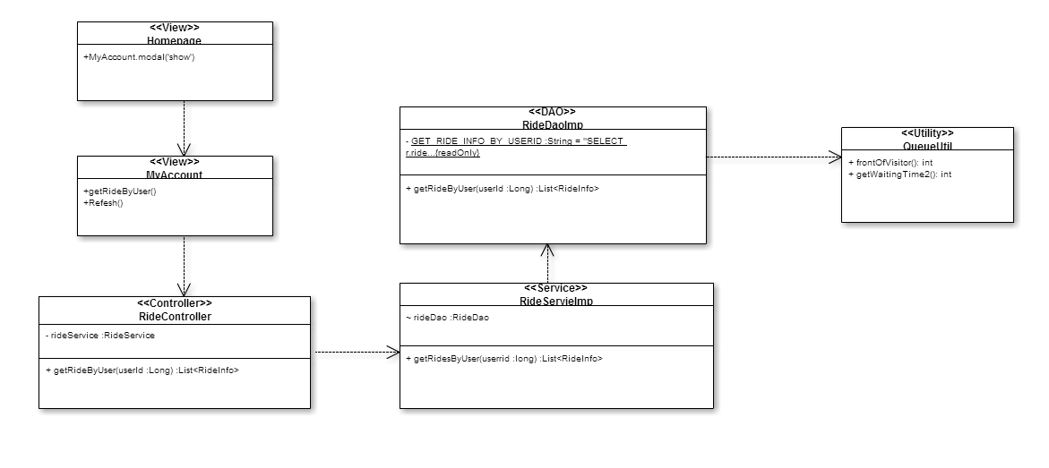
Class Diagram: Added in Design Document

Slide 11

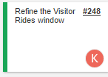
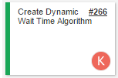
Daily Scrums 5 & 6
Daily Scrum 5
Continue coding methods in the objects class diagram.
Create methods to find # of visitors in front of specific visitor in a line.
Estimated points to work on:6 points
Actual number of points work on: 3 points
Daily Scrum 6
Continue coding methods in the objects class diagram.
Add new information to MyAccount table.
Create new methods with algorithm, using specific information on Visitor, Ride and # of people in front.
Estimated points to work on:4 points
Actual number of points work on: 3 points

Slide 12
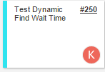
Daily Scrums 7 & 8
Daily Scrum 7
Finish coding methods in the objects class diagram.
Make sure My Account table with populated with correct information.
Start and finish testing the codes I made.
Estimated points to work on: 5 points
Actual number of points work on: 5 points
Daily Scrum 8
Finish testing the user story
Edit any changes I made in the code in the UML Diagram.
Estimated points to work on:5 points
Actual number of points work on: 4 points

Slide 13
Demo

Slide 14
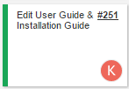
Daily Scrums 9 & 10
Daily Scrum 9
Edit User Guide and Installation Manual if needed.
Edit any changes I made in the code in the UML Diagram.
Estimated points to work on: 4 points
Actual number of points work on: 3 points
Daily Scrum 10
Sprint 4 Review with our product owner
Estimated points to work on:3 points
Actual number of points work on: 3 points
Total Points Estimated to Work on: 47 Points
Total Points Actually Done: 36 Points

Slide 15
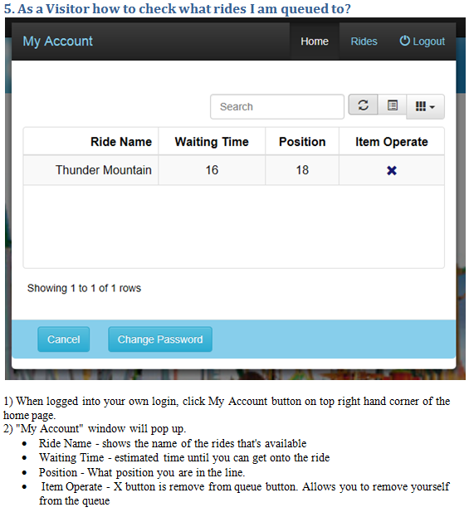
Edited the My Account section of User Guide
No edits made to Installation Manual

Slide 16
Sprint 4 Report
Dynamic Find Wait Time: User Story (Accepted)

Slide 17
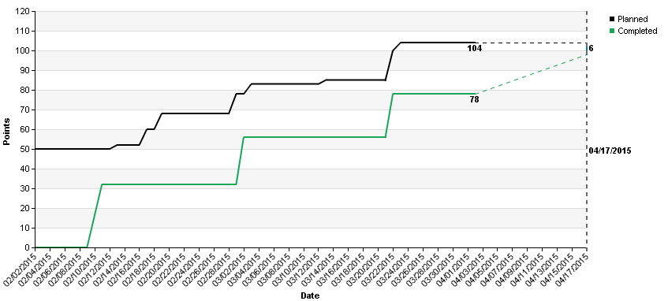
Burn-up charts

Slide 18
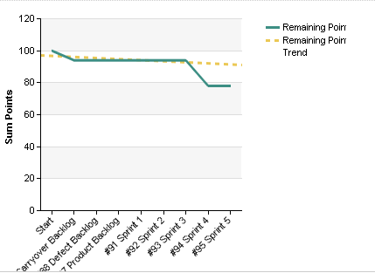
Burn Down charts

Slide 19
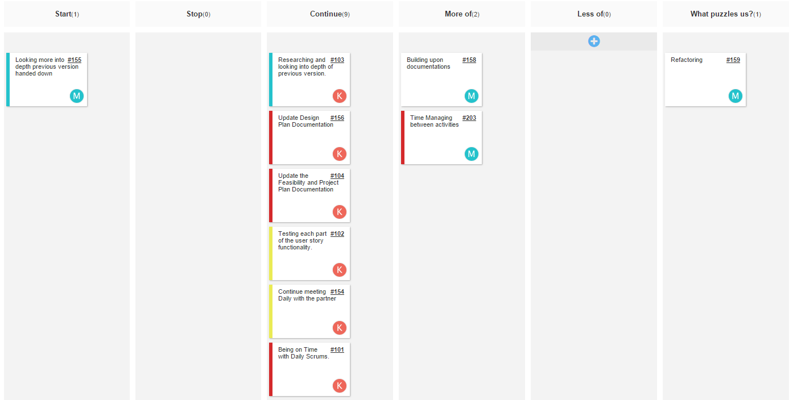
Retrospectives

Slide 20
Sprint 5 Planning
Send Notification
As a Visitor, I should be able to get notification every time we queue up to a ride.

